Slide 1
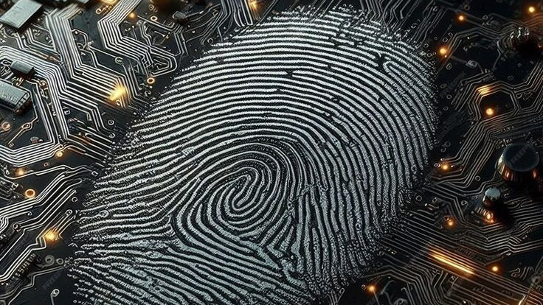
Digital Forensics Investigation: State v. John Smith
Evidence Recovery & Analysis (Project ID: CIS-3345-LO-NS-SL)
By: Luis de Oliveira, Seth Lackey and Nicholas Schreen
Notes:
Good morning. we are presenting our digital forensics investigation strategy for the case of State v. John Smith. My name is Seth, the Lead Investigator. I am joined by Luis, our Evidence Analyst, and Nicholas, our Documentation Lead. Our goal today is to outline the methodology we are using to analyze the suspect's digital footprint and determine the validity of the cyberbullying allegations.

Slide 2

Case Overview & Objective
Scenario: Investigation of a Windows 10 desktop belonging to suspect John Smith.
Allegation: Cyberbullying, harassment of Jane Doe, and distribution of non-consensual media ("meme" video).
Objectives
  Recover Chat Logs.
  Locate the “meme” video and prove authorship.
  Analyze web activity for distribution.
  Investigative physical transfer (USB).
Notes:
To provide the technical context: We are analyzing a forensic image of a Windows 10 desktop belonging to the suspect, John Smith. The allegations involve the creation of a harassing video and the distribution of threats against Jane Doe. From an analyst's perspective, our targets are specific:
Chat Logs: To find the threats.
File System: To recover the deleted 'meme' video.
Web History: To track the upload.
Registry: To check for external device transfers."

Slide 3

Investigation Roadmap
Milestone 1:Chat Application Artifacts (Discord & Steam).
User Story: Recover messages containing insults/threats to Jane Doe.
User Story: Identify communications related to harassment on gaming platforms.
Milestone 2: Video Artifacts (Recovery & Metadata).
User Story: Locate the "meme" video file deleted from the hard drive.
User Story: Prove the video was created/edited on this machine.
Milestone 3: Browser History (Web Distribution).
User Story: Did the suspect upload the video online?
Milestone 4: USB Device History (Physical Exfiltration).
User Story: Was the video transferred to an external drive?
Milestone 5: Case Management (Timeline & Final Report).
User Story: Correlate all artifacts into a single narrative.
User Story: Produce a professional legal conclusion.
Notes:
To ensure a chain of custody and organized reporting, we have divided the investigation into five clear milestones.
Milestone 1: Chat Analysis (Discord & Steam).
Milestone 2: Media Forensics (Video Recovery).
Milestone 3: Web Activity.
Milestone 4: Device History.
Milestone 5: Final Reporting. This structure ensures every artifact we analyze is properly documented and correlates to the specific allegations."

Slide 4

Milestone 1 - Discord Analysis
User Story: Recover messages containing insults/threats to Jane Doe.
Extraction:
  Target: C:\Users\John Smith\AppData\Roaming\Discord\
  Action: Extract core SQLite database files (.db).
Analysis:
  Tool: DB Browser for SQLite.
  Query: Filter by Date (Oct 2025) and Keywords ("Jane Doe", threats).
Validation: Document cryptographic hashes of extracted DBs.
Notes:
We start with Milestone 1: Discord Analysis. This is where the primary threats allegedly occurred. My focus here is on the narrative analysis. Once the data is extracted, I am using DB Browser for SQLite to query the message databases. We are filtering specifically for the date range of October 2025 and running SQL queries for keywords like 'Jane Doe' to isolate the specific messages proving intent to harass."

Slide 5
Milestone 1 - Steam Chat Logs
User Story: Identify communications related to harassment on gaming platforms.
Process:
  Locate: Navigate to \Steam\userdata\[ID]\ to find specific user logs.
  Search: Run keyword searches for victim's name or video title.
Evidence: Screenshot incriminating conversations for the report appendix.
Notes:
While Seth handles the Discord queries, I am handling the extraction of the Steam client data. I will navigate to the Steam\userdata directory on the disk image to locate John Smith's unique ID folder. The goal here is to identify if the harassment extended into gaming sessions. I will extract the log files and run text-based searches to find any mention of the video or the victim, ensuring we capture the full scope of his digital communication."

Slide 6
Milestone 2 - Video Recovery (File Carving)
User Story: Locate the "meme" video file deleted from the hard drive.
Method 1: File Carving.
  Tool: Scalpel or Foremost.
  Target: Unallocated Space (scanning for headers/footers).
Method 2: Hash Search
  Action: Run SHA-256 hash match against the disk image to find specific file signatures.
Notes:
Moving to Milestone 2: Recovering the 'Meme' Video. Since the file was reported deleted, our team is documenting the recovery process carefully. We are using Scalpel to carve unallocated space, searching specifically for video headers. If a hash was provided in the complaint, we are also verifying any recovered files against that SHA-256 hash to confirm we have found the correct piece of evidence for the report."

Slide 7
Milestone 2 - Proving Authorship
User Story: Prove the video was created/edited on this machine.
Metadata Analysis:
  Tool: ExifTool.
  finding: Extract Creation and Modification timestamps.
System Artifacts:
  Prefetch: Analyze C:\Windows\Prefetch for video editing software execution.
  Registry (UserAssist): Decode ROT13 keys in NTUSER.DAT to show run counts of editing tools.
Notes:
Recovering the video is step one; proving John Smith made it is step two. I am analyzing the correlation between the video file and the system's execution history. We are looking at the Prefetch files. If I see that video editing software—like DaVinci Resolve—was executed minutes before the video creation timestamp, that helps us establish a timeline of intent and creation directly tied to this user account

Slide 8
Milestone 3 - Browser Forensics
User Story: Did the suspect upload the video online?
History Analysis:
  Artifacts: Chrome/Edge History & Downloads.
  Filter: Look for upload sites (YouTube, Drive, Discord Web).
Cache Analysis:
  Search browser cache for thumbnails/fragments of the video file to prove it was processed by the browser.
Notes:
For Milestone 3, I am digging into the browser artifacts to trace distribution. I am extracting history databases from Chrome and Edge. My technical task is to parse these databases and the browser cache. I am looking for two things:
Visits to upload sites like YouTube or Google Drive.
Cached thumbnails of the video, which proves the file was rendered in the browser for an upload."

Slide 9
Milestone 4 - USB Device History
User Story: Was the video transferred to an external drive?
Registry Analysis:
  SYSTEM Hive: Check CurrentControlSet\Enum\USBSTOR for device Serial Numbers.
  NTUSER.DAT Hive: Check MountedDevices to link Volume GUIDs to the user.
Goal: Correlate USB connection times with the video creation timestamp.
Notes:
Milestone 4 covers Physical Distribution. I am documenting the registry analysis to determine if the video was moved offline. We are examining the SYSTEM Hive to list all connected USB devices and their serial numbers. I will then cross-reference this with the NTUSER.DAT hive to see if those specific drives were mounted by John Smith's user account during the timeframe of the harassment."

Slide 10
Milestone 5 - Timeline Reconstruction
User Story: Correlate all artifacts into a single narrative.
Process :
  Aggregation: Combine timestamps from Chat, Prefetch, File System, and Browser into one spreadsheet.
  Sorting: Chronological order to show cause-and-effect.
Narrative
  Example Chain: App Launch -> Video Created -> Web Upload -> Chat Confirmation.
Notes:
All of this brings us to Milestone 5: The Master Timeline. This is where we build the case narrative. I am taking the data from the Chat logs, the Video metadata, the Browser history, and the USB registry, and aligning them chronologically. This allows us to present a 'smoking gun' sequence to the court: showing exactly when he opened the editor, created the video, and sent the threatening message."

Slide 11
Milestone 5 - Reporting & Conclusions
User Story: Produce a professional legal conclusion.
Findings:
  Drafting the "Findings" (Evidence Summary) and "Conclusion" (Guilt/Innocence statement).
Final Polish:
  Formatting PDF, adding Table of Contents, and compiling Appendices (Screenshots, Logs, Chain of Custody).
Notes:
ensuring the technical accuracy of our Final Report. We are compiling the 'Findings' section, which summarizes the artifacts I've extracted. Crucially, I am ensuring that every technical claim is backed by raw data—exporting the CSVs of the chat logs and the hex dumps of the registry keys—so that our forensic conclusion is technically irrefutable."

Slide 12

Project Status & Q&A
Current Status:
Investigation Complete
Outcome:
All artifacts (Chat, Video, Web, USB) have been successfully recovered and correlated.
Notes:
In conclusion, I am pleased to report that the investigation is now fully complete.
We have successfully executed all phases of the project.

